Slide 1
Online Vehicle Dealers Web Based System
Presented by Onila and Thamali

Slide 2

Content
Introduction
Navigation Map
Database Relationship Diagram (ER Diagram)
User Interfaces
Business Logic

Slide 3
Introduction
What is this Online Car Dealers?
Objectives of this Web Site

Slide 4
Navigation Map
Sign Up
Login
Home
All Ads
Post Ad
Login
View Ads
Create Ad
Login
Signup
Logout
Serach Ad
Sort Ad by Category
Sort Ad by Price
Sort Ad by Date
Comment Ad
Rate Ad
Report Ad
Sort Ad by Location

Slide 5
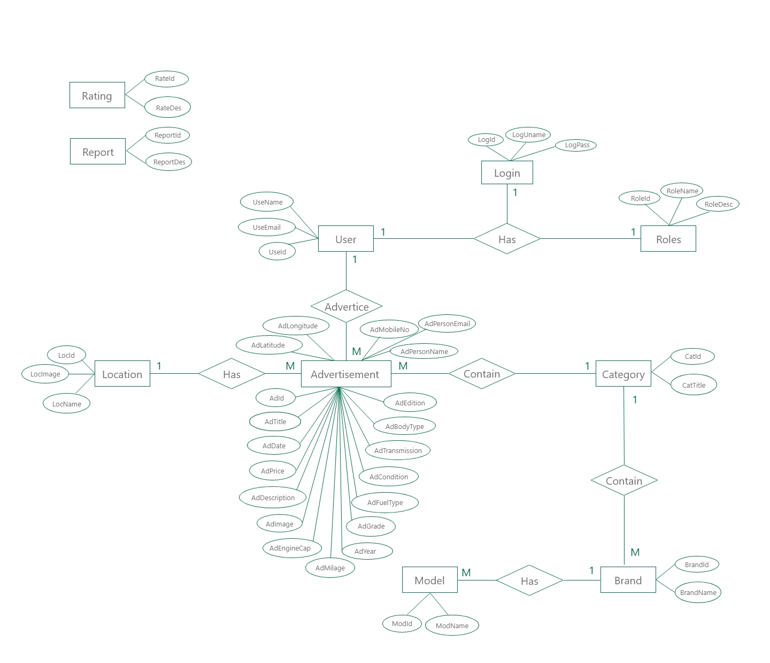
Database Relationship Diagram

Slide 6
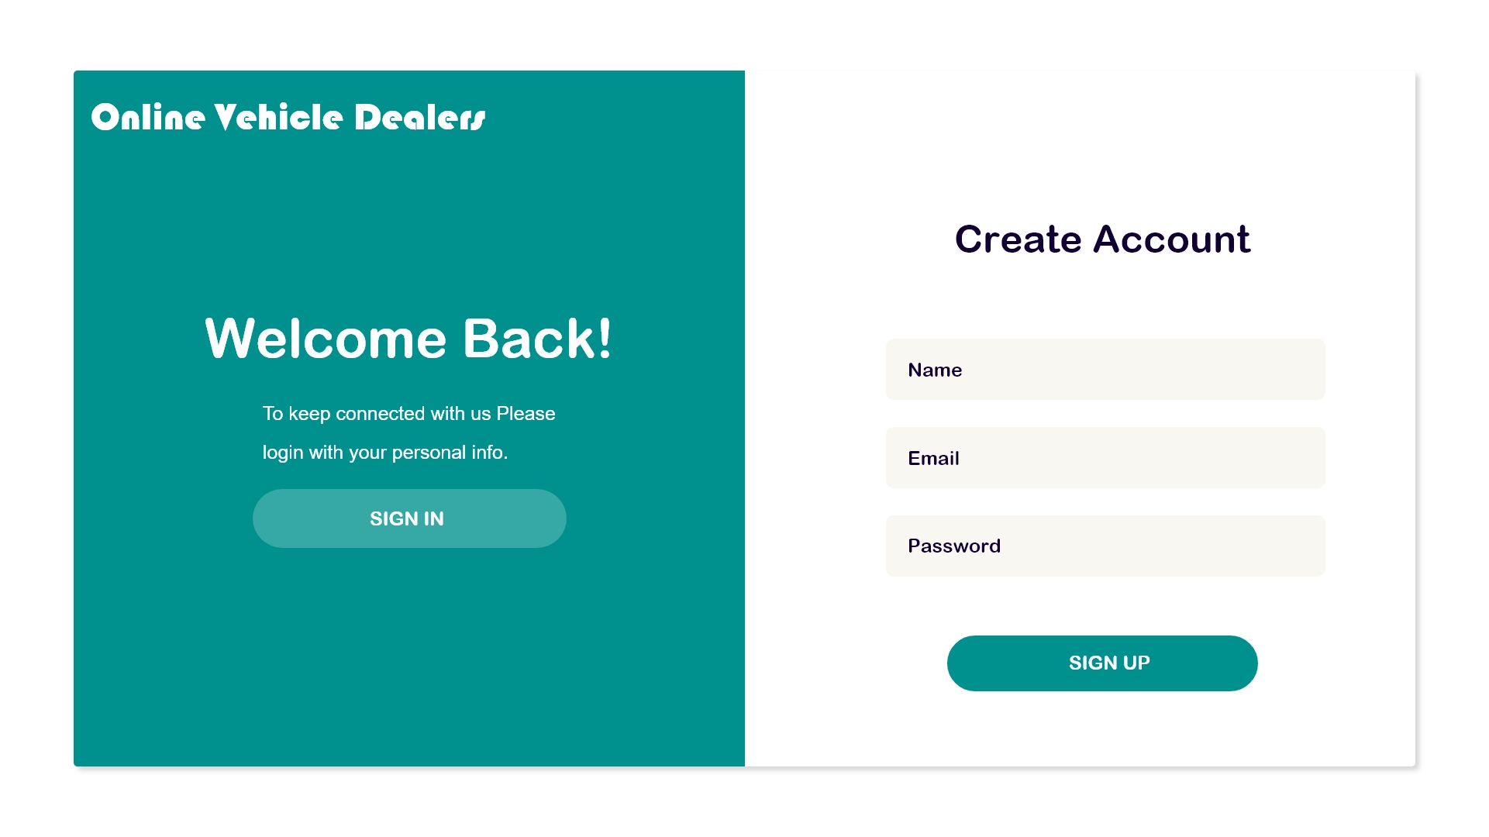
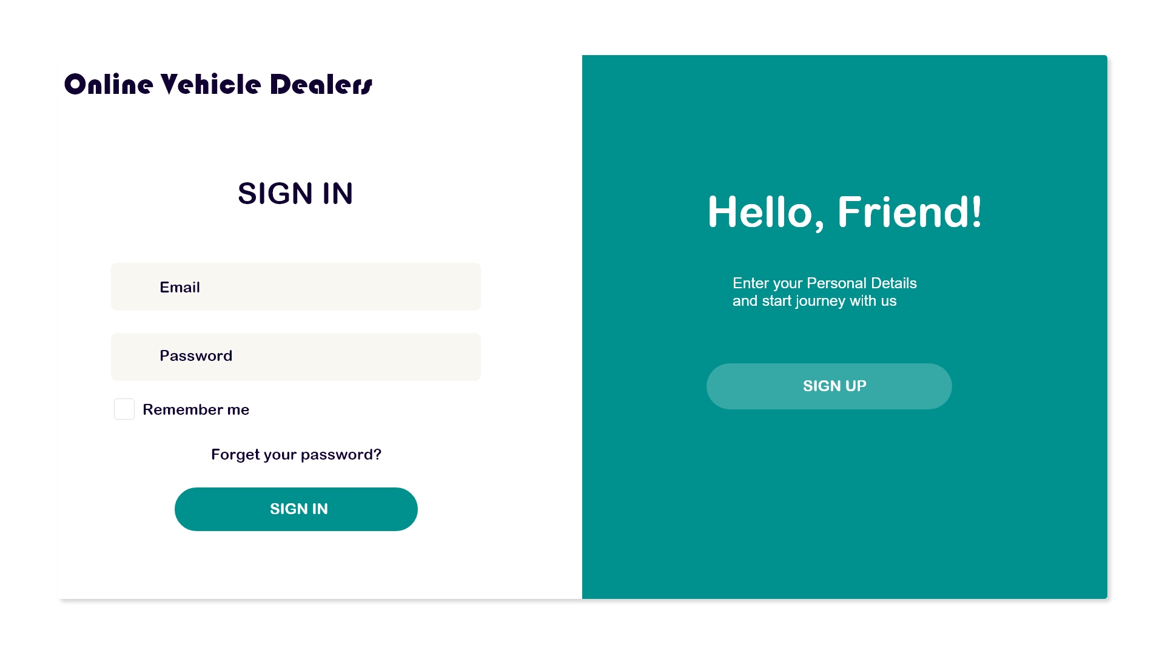
User Interfaces
Sign Up Page Login Page

Slide 7
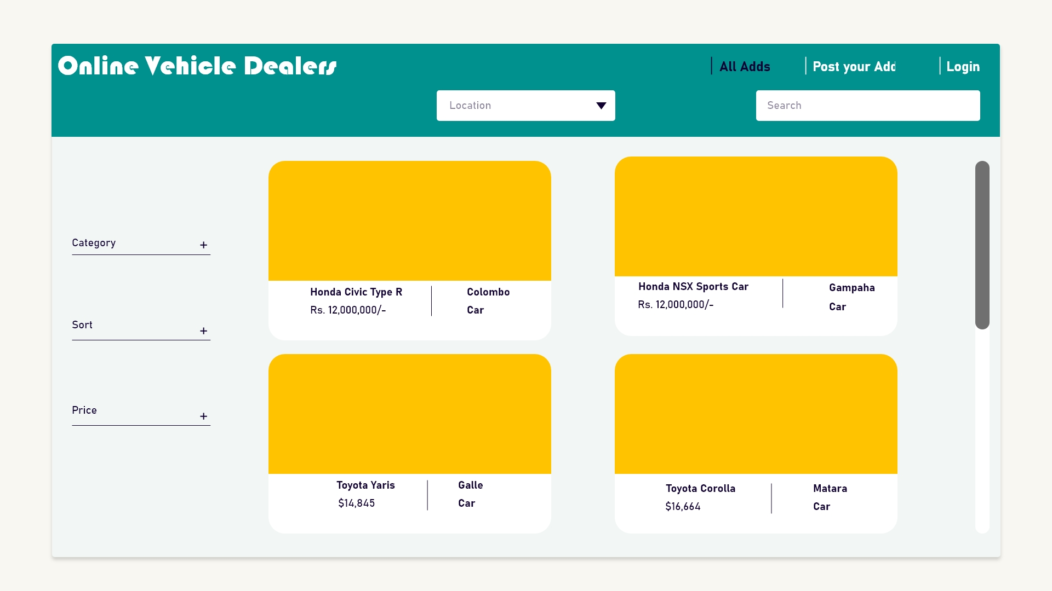
Home Page

Slide 8
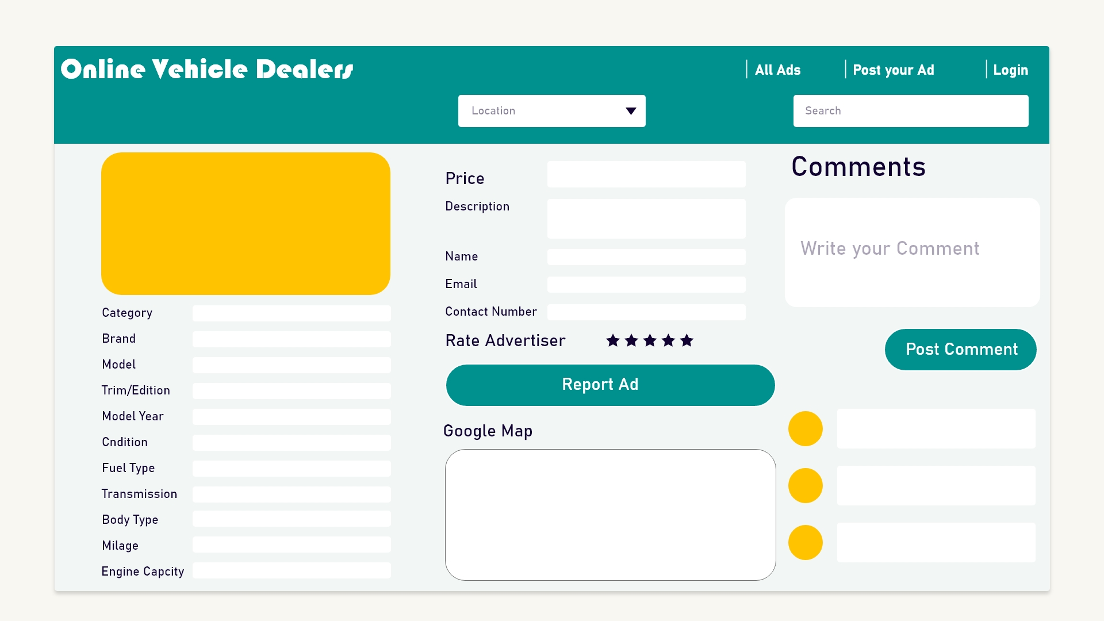
When Click on One Advertisement

Slide 9
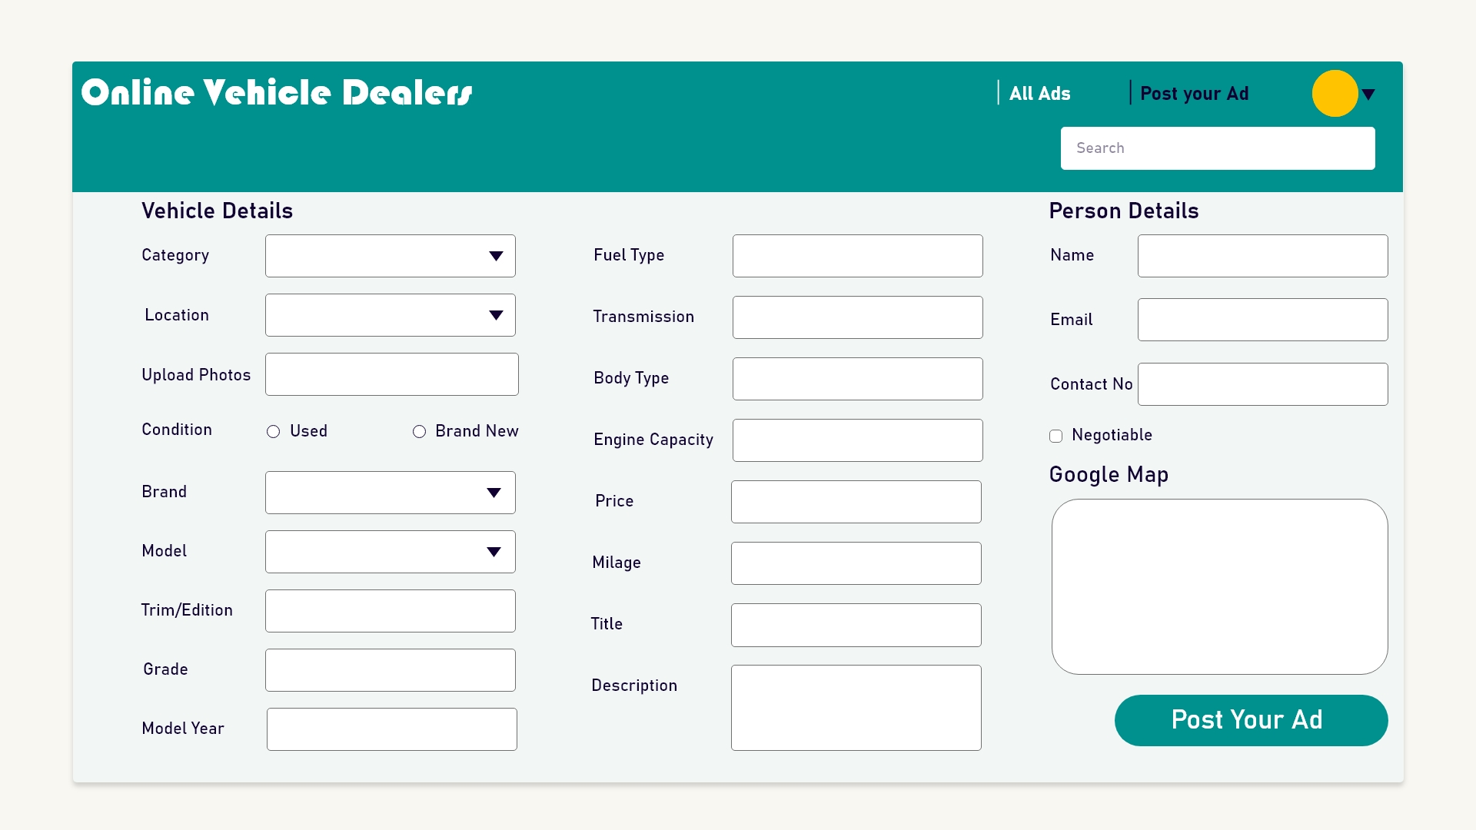
Create an Advertisement

